Slide 1
Processor logic design
By Tahseen Asma Meem

Slide 2
Processor organization
A processor unit is a part of a digital system that implements operations in the system.
It comprises a number of registers and digital functions that implement arithmetic, logic, shift, and transfer micro-operations.
The processor unit when combined with a control unit that supervises the sequence of micro-operations is called a central processing unit (CPU).
A central processing unit (CPU) consists of MEMORY (Register banks), ARITHMETIC LOGIC UNIT (ALU), and CONTROL UNIT (CU).
There are three organizations for organizing a general-purpose processor unit:
Bus organization
Scratchpad memory
Two-port memory

Slide 3
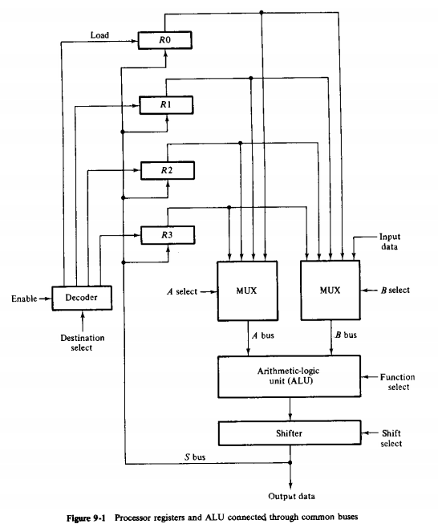
BUS organization
A bus organization has four registers, each register is connected to two multiplexers to form two buses A and B.
To perform the micro-operation: R1 = R2 + R3
The control unit must provide binary selection variables to the following selector inputs –
MUX A Selector: to place contents of R2 onto bus A
MUX B Selector: to place contents of R3 onto bus B
ALU Function Selector: to provide the arithmetic operation A + B
Shift Selector: for direct transfer from the output of the ALU onto output bus S (no shift)
Decoder Destination Selector: to transfer the contents of bus S into R1

Slide 4
bus organization
The five control selection variables must be generated simultaneously and must be available during one common clock pulse interval.
The binary information from the two source registers propagates through the combinational gates in the multiplexers, the ALU, and the shifter, to the output bus and into the inputs of the destination register all during one clock pulse interval.
Then, when the next clock pulse arrives, the binary information on the output bus is transferred to R1.

Slide 5
Scratchpad memory
The registers in a processor unit can be enclosed within a small memory unit. When included in a processor unit, a small memory is sometimes called a scratchpad memory.
The use of a small memory is a cheaper alternative to connecting processor registers through a bus system. The difference between the two systems is the manner in which information is selected for transfer into the ALU.
In the bus system, the information transfer is selected by the multiplexers that form the buses.
On the other hand, a single register in a group of registers organized as a small memory must be selected by means of an address to the memory unit.

Slide 6
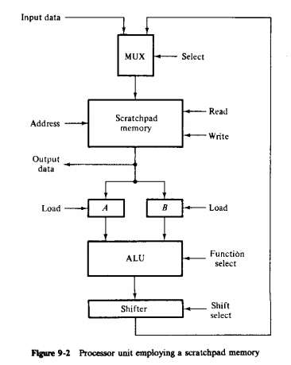
Scratchpad memory
To perform the operation R1=R2+R3, the control must provide binary selection variables to perform the following sequence of three micro-operations:
T1: A ← M[010] Read R2 into register A
T2: B ← M[011] Read R3 into register B
T3: M [001] ← A+B Perform operation in ALU and transfer result to R1
The reason for a sequence of three micro-operations, instead of just one as in a bus-organized processor, is due to the limitation of the memory unit. Since the memory unit has only one set of address terminals but two source registers are to be accessed.

Slide 7
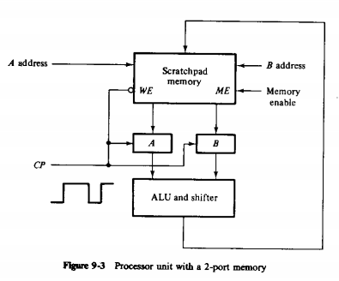
Processor Unit with two port memory
Some processors employ a 2-port memory in order to overcome the delay caused when reading two source registers. If the destination register is the same as one of the source registers, then the entire micro-operation can be done within one clock pulse period.
When Clock = 1, A and B latches are open and accept information coming from memory. The WE’ is also in 1 state and disables write operation and enables read operation. Thus when Clock =1, words selected by A and B addresses are read from memory and placed in A and B registers.
When Clock = 0, the latches are closed and retain the last data entered. ALU operation is performed and if write is enabled since Clock = 0, and also ME input is enabled, the result of the micro-operation is written into memory word defined by B address.

Slide 8
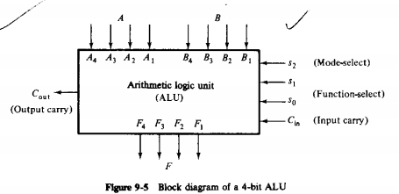
Arithmetic logic unit(ALU)
An ARITHMETIC LOGIC UNIT (ALU) is a multi-operation, combinational logic digital function. It can perform a set of basic arithmetic operations and a set of logic operations. The ALU has a number of selection lines to select a particular operation in the unit. The selection lines are decoded within the ALU so that k selection variables can specify up to 2^𝐾 distinct operations.
The mode select s2 distinguishes between arithmetic and logic operations.
The two functions select inputs s1 and s0 and specify the particular arithmetic and logic operation to be generated.
The input and output carry (Cin and Cout) have meanings only during arithmetic operations.
The input carry Cin in the least significant position of an ALU is quite often used as the fourth selection variable that can double the number of arithmetic operations. Thus a total of 8 arithmetic operations and 4 logical operations can be performed.

Slide 9
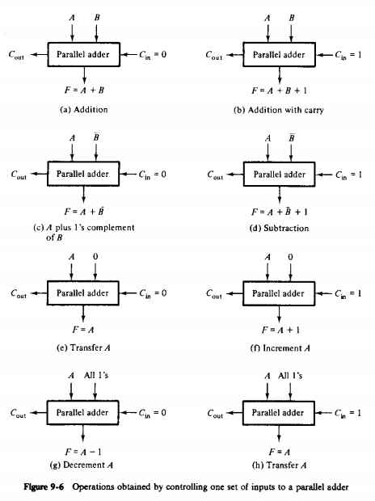
Design of arithmetic unit
The basic component of the arithmetic section of an ALU is the parallel adder.
A parallel adder is constructed with a number of full adder circuits cascaded.
By controlling the data inputs to the parallel adder, it is possible to obtain different types of arithmetic operations.
𝑆1 𝑆0 = 01 then (a) and (b)
𝑆1 𝑆0 = 10 then (c) and (d)
𝑆1 𝑆0 = 00 then (e) and (f)
𝑆1 𝑆0 = 10 then (g) and (h)

Slide 10
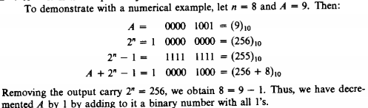

Design of arithmetic unit
The condition illustrated in Fig.9-6(g) inserts all 1’s into B terminals. This produces a decrement operation F=A-1. To show this operation, consider a parallel adder with n full adder circuits. When the output carry is 1, it represents the number $2^{n}$ , because $2^{n}$ in binary consists of a 1 followed by n 0’s. Subtracting 1 from $2^{n}$, we obtain $2^{n}$-1 which in binary is a number of n 1’s. Adding $2^{n}$-1 to A, we obtain F=A+$2^{n}$-1=$2^{n}$+A-1. If output carry $2^{n}$ is removed then we obtain F=A-1.

Slide 11
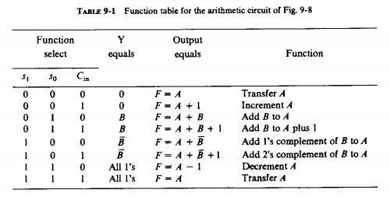
Design of arithmetic unit

Slide 12
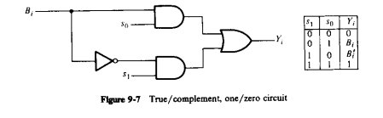
True/Complement, one/zero Circuit
The values of the Y inputs to the full-adder circuits are a function of selection variables 𝑆1 and 𝑆0 .
The arithmetic circuit needs a combinational circuit in each stage specified by Boolean functions –
Xi = Ai
Yi = BiS0 + Bi’S1 , i= 1,2,3,...,n

Slide 13
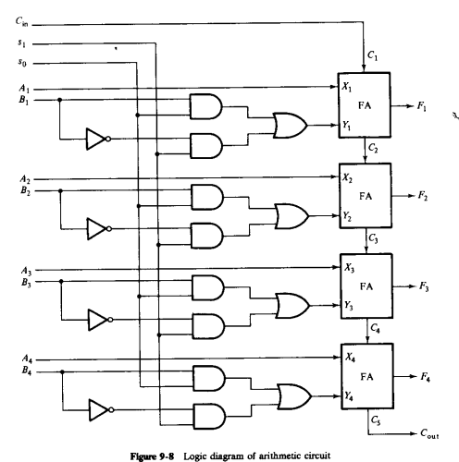
4 bit Arithmetic circuit

Slide 14
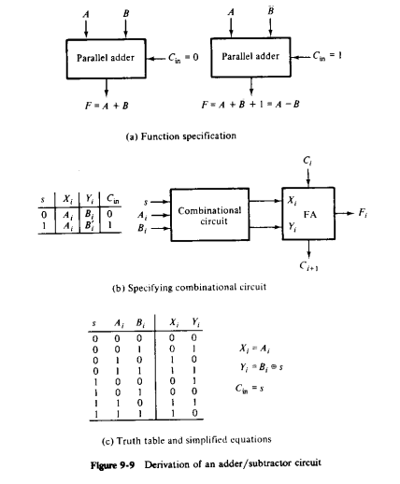
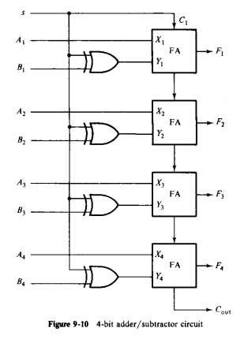
4 bit Adder/subtractor circuit
HOMEWORK: Design an adder/subtractor circuit with one selection variable s and two inputs A and B: when s= 0 the circuit performs A+B. When S=1 the circuit performs A-B by taking the 2’s complement of B.
Solution:

Slide 15
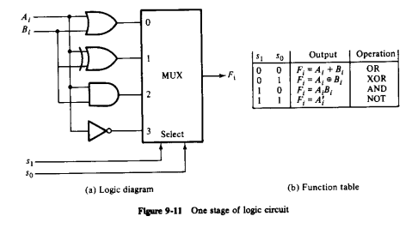
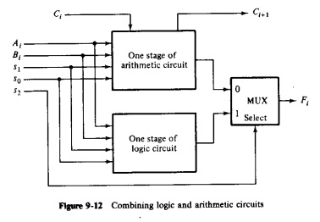
Logical circuit
The logic micro-operations manipulate the bits of the operands separately and treat each bit as a binary variable.
All logic operations can be obtained by means of AND, OR, and NOT operations.
For 3 operations, we need 2 selection variables but 2 selection lines can choose between 4 logic operations, and hence XOR operation was also incorporated into the logical circuit.
The logic circuit can be combined with the arithmetic circuit to produce one arithmetic logic unit.
Selection variables s1 and s0 can be made common to both sections, provided we use a third variable s2 to differentiate between the two.

Slide 16
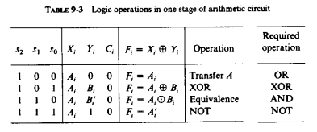
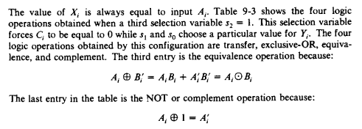
Logical circuit

Slide 17
Arithmetic Logic circuit
Design a 2-bit ALU for the operations listed below in the Table:
Binary Code |  |  | Function of selection variables
 | B | A | F with C_{in} = 0 | F with C_{in} = 1 | D | H
0 0 0 | Input Data | Input Data | A | A+1 | None | Circulate-Left with Carry
0 0 1 | R1 | R1 | A+B | A+B+1 | R1 | Circulate-Right with Carry
0 1 0 | R2 | R2 | A+B` | A+B`+1 | R2 | No shift
0 1 1 | R3 | R3 | A-1 | A | R3 | 0’s to the output Bus
1 0 0 | R4 | R4 | A OR B | A OR B | R4 | -
1 0 1 | R5 | R5 | A XOR B | A XOR B | R5 | Shift Left with I_{L}=0
1 1 0 | R6 | R6 | A AND B | A AND B | R6 | Shift Right with I_{R}=0
1 1 1 | R7 | R7 | A′ | A′ | R7 | 1’s to the output Bus

Slide 18
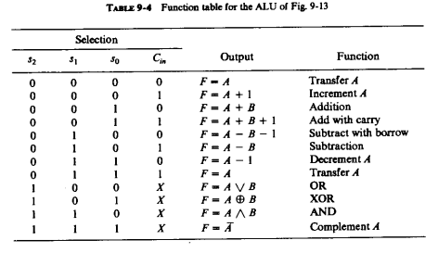
Arithmetic Logic circuit
Xi | Yi | Zi
A | 0 | 0
A | 0 | 1
A | B | 0
A | B | 1
A | B` | 0
A | B` | 1
A | 1 | 0
A | 1 | 1
A+B | 0 | 0
A | B | 0
A+B` | B` | 0
A | 1 | 0

Slide 19
Arithmetic Logic circuit
S0 S2S1 | 0 | 1
00 | A | A
01 | A | A
11 | A+B` | A
10 | A+B | A
S0 S2S1 | 0 | 1
00 | 0 | B
01 | B` | 1
11 | B` | 1
10 | 0 | B
S0Cin S2S1 | 00 | 01 | 11 | 10
00 | 0 | 1 | 1 | 0
01 | 0 | 1 | 1 | 0
11 | 0 | 0 | 0 | 0
10 | 0 | 0 | 0 | 0
Yi=S0Bi`+S1Bi`
Xi=Ai+S2S1S0`Bi`+S2S1`S0`Bi
Zi=S2`Cin

Slide 20
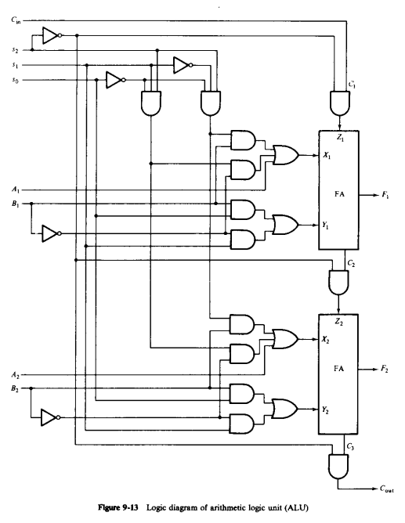
Arithmetic Logic circuit

Slide 21
SHIFTER DESIGN
Design a 3-bit shifter for the shifting operations listed below in the Table:
Binary Code |  |  | Function of selection variables
 | B | A | F with C_{in} = 0 | F with C_{in} = 1 | D | H
0 0 0 | Input Data | Input Data | A | A+1 | None | Circulate-Left with Carry
0 0 1 | R1 | R1 | A+B | A+B+1 | R1 | Circulate-Right with Carry
0 1 0 | R2 | R2 | A+B` | A+B`+1 | R2 | No shift
0 1 1 | R3 | R3 | A-1 | A | R3 | 0’s to the output Bus
1 0 0 | R4 | R4 | A OR B | A OR B | R4 | -
1 0 1 | R5 | R5 | A XOR B | A XOR B | R5 | Shift Left with I_{L}=0
1 1 0 | R6 | R6 | A AND B | A AND B | R6 | Shift Right with I_{R}=0
1 1 1 | R7 | R7 | A′ | A′ | R7 | 1’s to the output Bus

Slide 22
SHIFTER DESIGN

Slide 23
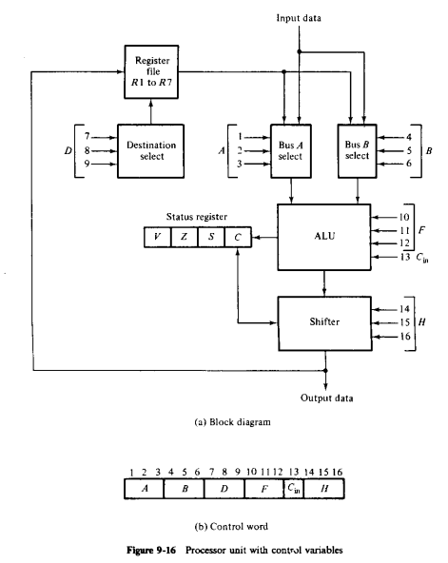
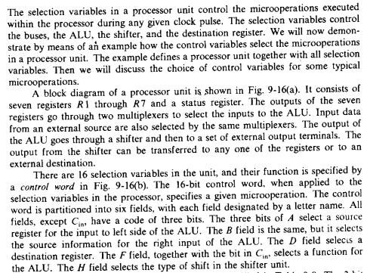
Processor unit

Slide 24
Processor unit
Binary Code |  |  | Function of selection variables
 | B | A | F with C_{in} = 0 | F with C_{in} = 1 | D | H
0 0 0 | Input Data | Input Data | A | A+1 | None | Circulate-Left with Carry
0 0 1 | R1 | R1 | A+B | A+B+1 | R1 | Circulate-Right with Carry
0 1 0 | R2 | R2 | A+B` | A+B`+1 | R2 | No shift
0 1 1 | R3 | R3 | A-1 | A | R3 | 0’s to the output Bus
1 0 0 | R4 | R4 | A OR B | A OR B | R4 | -
1 0 1 | R5 | R5 | A XOR B | A XOR B | R5 | Shift Left with I_{L}=0
1 1 0 | R6 | R6 | A AND B | A AND B | R6 | Shift Right with I_{R}=0
1 1 1 | R7 | R7 | A′ | A′ | R7 | 1’s to the output Bus

Slide 25
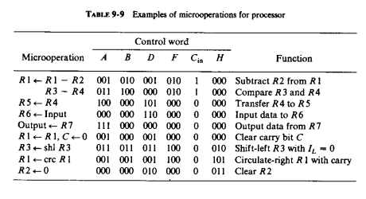
Processor unit

